Slide 1
数字系统设计 第三次实验课
主要内容： 1. lab3 + 2. pre lab4
卓若凡
2021.4.1

Slide 2
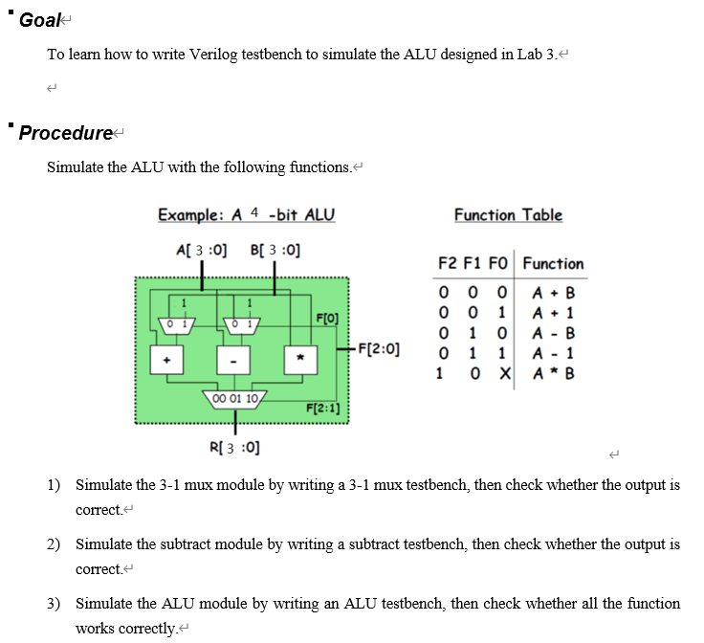
1. lab3

Slide 3
1. lab3
仿真分类
Behavior simulation
Post-synthesis functional simulation
Post-synthesis timing simulation
Post-implementation functional simulation
Post-implementation timing simulation

Slide 4
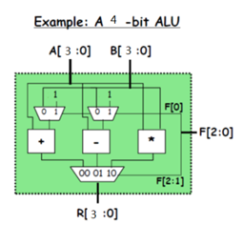
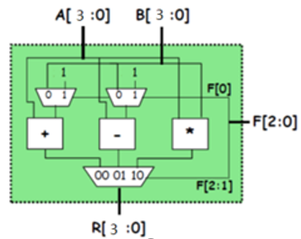
1. lab3
Test bench
module ALU(
input [3:0] A,
input [3:0] B,
input [2:0] F,
output [3:0] R
);
endmodule
module ALU_tb();
reg [3:0] A,B;
reg [2:0] F;
wire [3:0] R;
ALU m1(.A(A),.B(B),.F(F),.R(R));
endmodule

Slide 5
2. Pre lab4
设计和实现 ON/OFF button
考虑亚稳态（metastability）问题
考虑抖动（ bounce）问题

Slide 6
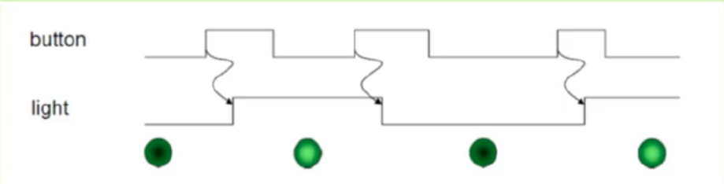
2. Pre lab4
ON/OFF Button
每次按下开关，灯状态取反，松开开关不影响灯

Slide 7
2. Pre lab4
ON/OFF Button
always@(posedge clk)
begin
if(button) light <= ~light
end
clock are fast
we are slow!
触发的关键是上升沿

Slide 8
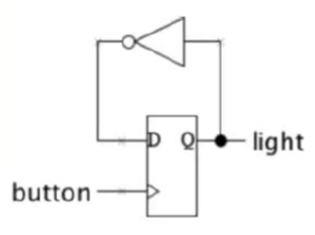
2. Pre lab4
ON/OFF Button
1.触发的关键是上升沿
时钟是时序电路中最特殊、最重要的信号。需严格满足触发器信号的保持时间、建立时间要求
需由专门的时钟信号提供固定频率的信号
always@(posedge button)
begin
if(button) light <= ~light
end

Slide 9
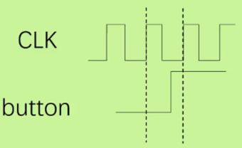
2. Pre lab4
ON/OFF Button
1.触发的关键是上升沿
2.需使用专用的时钟信号
if(old_button == 0 && button == 1) light <= ~light;
old_button <= button;

Slide 10
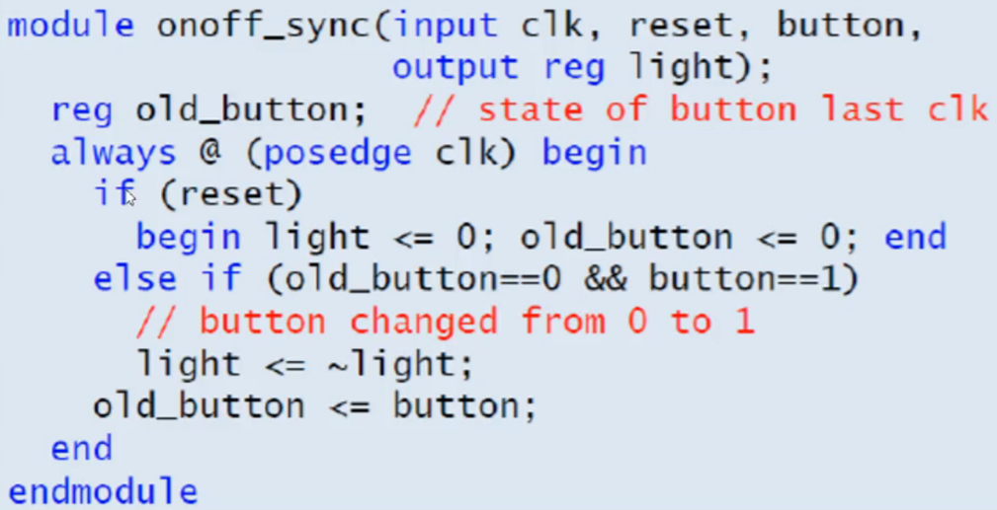
2. Pre lab4

Slide 11
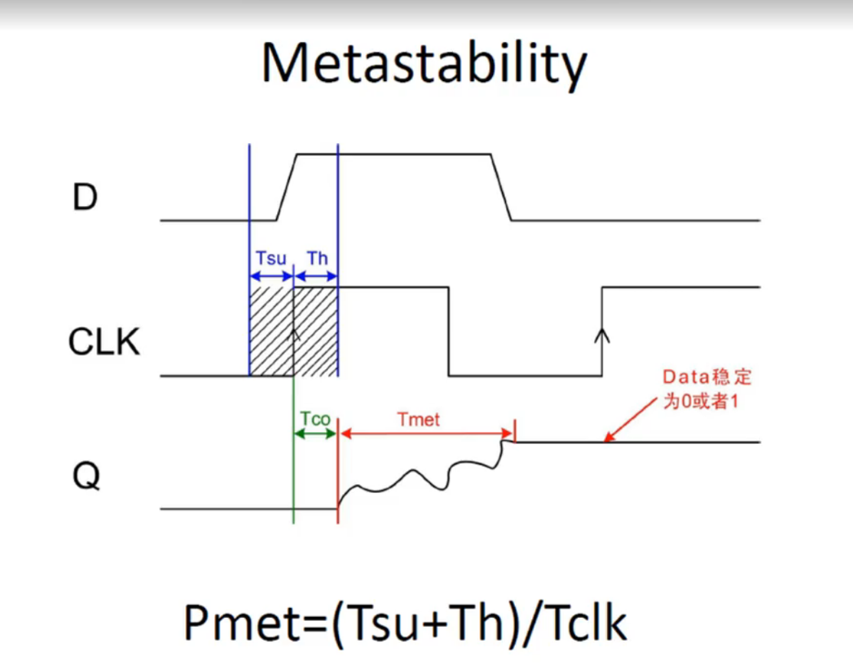
2. Pre lab4

Slide 12
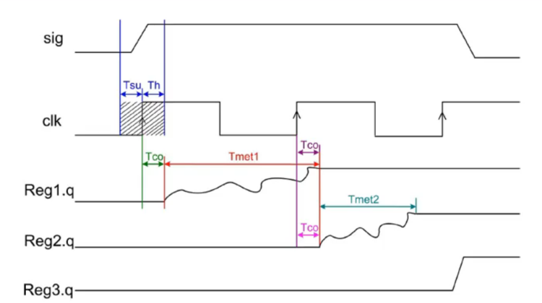
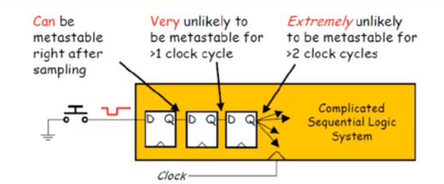

2. Pre lab4
Remove Metastability
任何时序电路亚稳态都可能出现
阻止亚稳态的传播并提供时间使其稳定下来：使用多级触发器连接

Slide 13
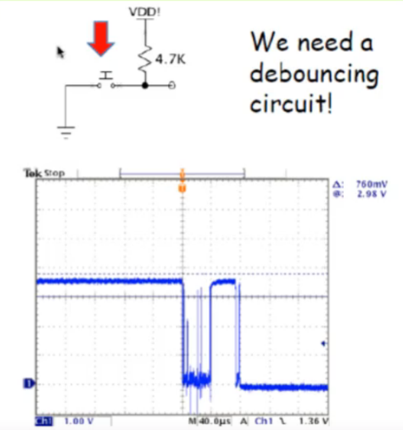
2. Pre lab4
ON/OFF Button
1.触发的关键是上升沿
2.需使用专用的时钟信号
3.消除亚稳态
Bounce

Slide 14
2. Pre lab4
ON/OFF Button
1.触发的关键是上升沿
2.需使用专用的时钟信号
3.消除亚稳态
4.去除抖动噪声
确保超过一定时间，才被认为是被按下
否则，被认为是噪声，舍弃
经验值：
650000CLK = 6.5ms

Slide 15
2. Pre lab4
module button(
input clk,reset,button_in,
output reg light
);
reg button,btemp;
always@(posedge clk)
{button,btemp} <= {btemp,button_in};
wire bpressed;
debounce d1(.clk(clk),.reset(reset),. bounce(button),. signal(bpressed));
reg old_bpressed;
always@(posedge clk)
begin
if(reset) begin light <= 0; old_bpressed <= 0; end
else if(old_bpressed == 0 && bpressed == 1) light <= ~light;
old_bpressed <= bpressed;
end
endmodule
module debounce(
input reset, clk, bounce,
output reg signal
);
parameter NDELAY = 650000;
reg [19:0] count;
reg xnew;
always@(posedge clk)
begin
if(reset) begin
xnew <= bounce; signal <= bounce; count <= 0;
end
else if(bounce!= xnew) begin
xnew <= bounce; count <= 0;
end
else if(count == NDELAY) signal <= xnew;
else count <= count + 1;
end
endmodule

Slide 16
可能的问题：
关于clk的仿真
clk，reset的约束引脚
按键的低电平有效和高电平有效

